Slide 1
Analysis of Salary Data
Data Scientist: Greg Hein
© 2024 Udacity.

Slide 2
Agenda
Findings of linear regression modeling
with tech salary data
Data Description
Regression Results
Interpretation of Model Results

Slide 3
Data Description
Data Description
Data Description
There are a total of 375 employees in the original dataset.
For each employee, the original dataset has entries for: Age, Gender, Education Level, Job Title, Years of Experience, and Salary.
To make use of Job Title column, it was analyzed to see whether certain words were contained in the Job Title
List of Job Title words used: Director, Junior, Senior, Manager, Analyst, Engineer

Slide 4
Data Description
After inspection, it was found 2 of the employees had null data so those two employees were dropped from the dataset leaving 373 employees.
The Salaries in the dataset range from $350 to $250,000

Slide 5
Data Description
Relationship between employee characteristics and Salary
-------------------------------------------------------------------
Average Salaries for each Education Level
Bachelor's 74756.026786
Master's 129795.918367
PhD 157843.137255
Average Salaries for each Gender
Female 97011.173184
Male 103867.783505
The average values for Salaries for Gender and Education Level here show differences that suggest an influence of both on Salary

Slide 6
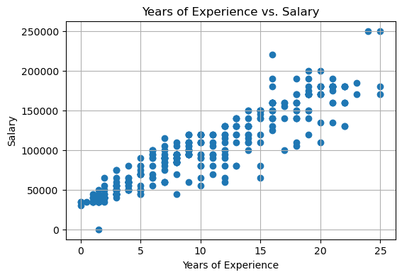
Data Description
Relationships between employee characteristics and Salary (cont’d)
Years of Experience plotted
Against Salary suggests
A linear relationship

Slide 7
Regression Results
After an initial regression run it was determined that the Job Title fields in the dataset associated with the words: junior, analyst, and engineer were not statistically significant.
Those fields were removed from the final linear regression model.
After their removal, all remaining fields were statistically significant.

Slide 8
Regression Results
OLS Regression Results
==============================================================================
Dep. Variable: Salary R-squared: 0.914
Model: OLS Adj. R-squared: 0.913
Method: Least Squares F-statistic: 557.4
Date: Wed, 10 Dec 2025 Prob (F-statistic): 1.46e-190
Time: 21:53:52 Log-Likelihood: -4092.6
No. Observations: 373 AIC: 8201.
Df Residuals: 365 BIC: 8233.
Df Model: 7
Covariance Type: nonrobust
============================================================================================
coef std err t P>|t| [0.025 0.975]
--------------------------------------------------------------------------------------------
intercept 2.876e+04 1677.411 17.146 0.000 2.55e+04 3.21e+04
Gender_Male 7629.6521 1481.834 5.149 0.000 4715.649 1.05e+04
is_director 2.498e+04 3503.028 7.131 0.000 1.81e+04 3.19e+04
is_senior 1.445e+04 1820.427 7.936 0.000 1.09e+04 1.8e+04
is_manager 4284.6595 1822.582 2.351 0.019 700.579 7868.740
Years of Experience 5104.4388 177.226 28.802 0.000 4755.927 5452.950
Education Level_Master's 1.404e+04 2032.078 6.908 0.000 1e+04 1.8e+04
Education Level_PhD 2.308e+04 2760.740 8.360 0.000 1.77e+04 2.85e+04
==============================================================================
Omnibus: 126.635 Durbin-Watson: 1.790
Prob(Omnibus): 0.000 Jarque-Bera (JB): 1010.895
Skew: 1.196 Prob(JB): 3.07e-220
Kurtosis: 10.702 Cond. No. 60.8
==============================================================================

Slide 9
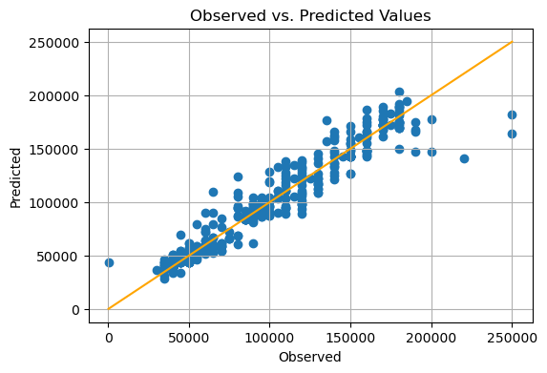
Regression Results

Slide 10
Interpretation of Model Results
Years of Experience
With each additional year of experience, the expected change in salary is an increase of $5,104.43.
We can be 95% confident that salary will increase between 4755.93 and 5452.95 dollars with each additional year of experience

Slide 11
Interpretation of Model Results
Senior Job Title
If the employee has a senior job title, the expected change in salary is an increase of $14,450.
We can be 95% confident that salary will increase between 10,900 and 18,000 dollars with a senior job title.

